Slide 1

Face Analysis for Customer Segmentation using Deep Learning
2022 Fall Semester
Capstone Design Project
모하마드 아즈라이 빈 마하단(2019320151)
컴퓨터학과

Slide 2
Table of Contents
01
02
03
04
Introduction
Background
Objective
Core Functions
System Design
Implementation
Methods
Tools
Model Development & Deployment
Conclusion
Future plan
Demo(시연)

Slide 3
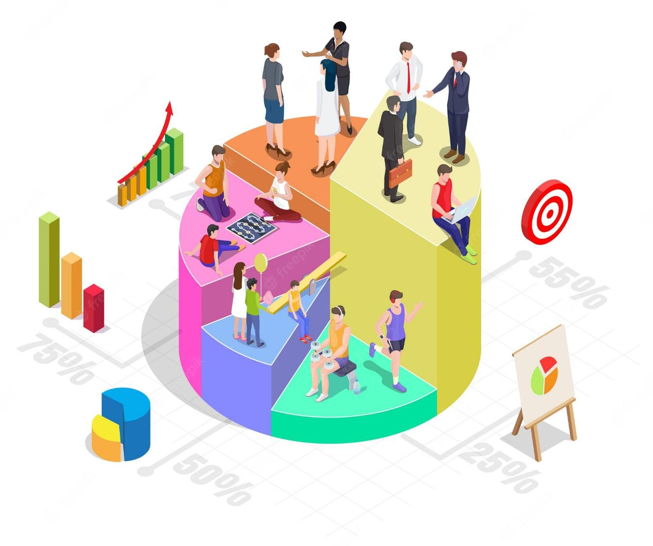
Part 1,
Introduction

Slide 4

Part 1,
Introduction
Background
Customer segmentation is a strategy
and important in marketing industry.
01 A lot of data can be analyzed from the customers that come to a shop.
02 There is a need to utilize the data to provide meaningful insights for the user.
03 By understanding the pattern of customer, user can increase business profits.

Slide 5
Part 1,
Introduction
Objective
Build web application that helps predicting and
automatically analyzing the demographic information like age, gender and race of the customers in real-time

Slide 6

Part 2,
Core Functions

Slide 7
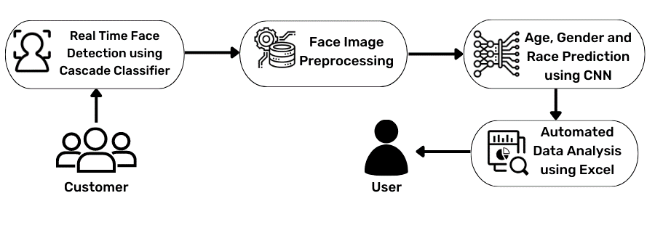
Part 2,
Core Functions
System Design
Web browser

Slide 8
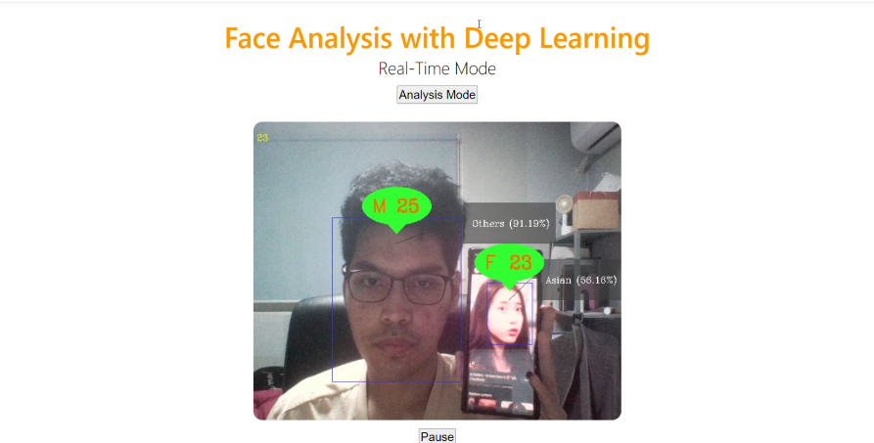
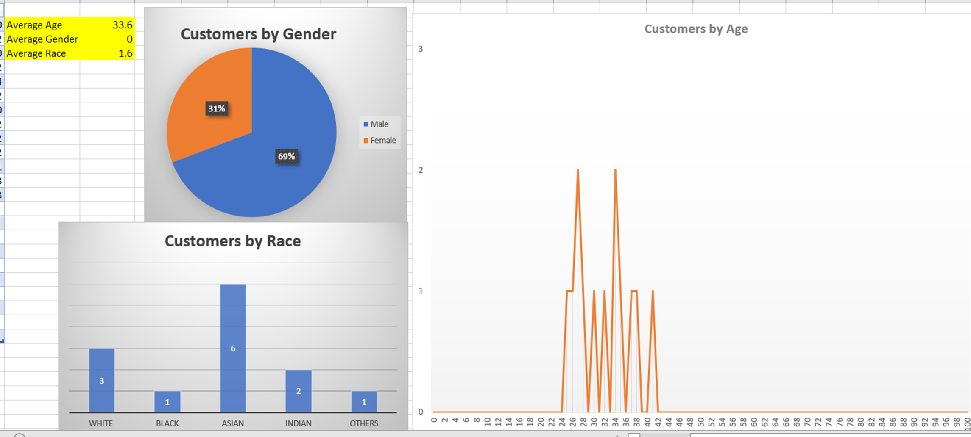
Part 2,
Core Functions
Implementation
Each 50 frames
Real-time(실시간) face detection and age, gender and race prediction
Customer information are analyzed “automatically” using Excel

Slide 9

Part 3,
Methods

Slide 10





Part 3,
Methods
Core Development Tools
Deep learning model building and development.
Configure video and real time broadcast
Model deployment into browser(also with use of HTML and CSS)
Post-prediction automated data analysis.
Main programming language that was used

Slide 11
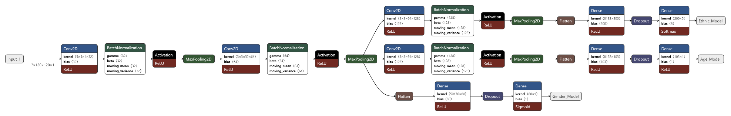
Part 3,
Methods
Model Development
<3 layers CNN with 3 output branch>
Trained using UTK Face dataset.
Functional API is used

Slide 12
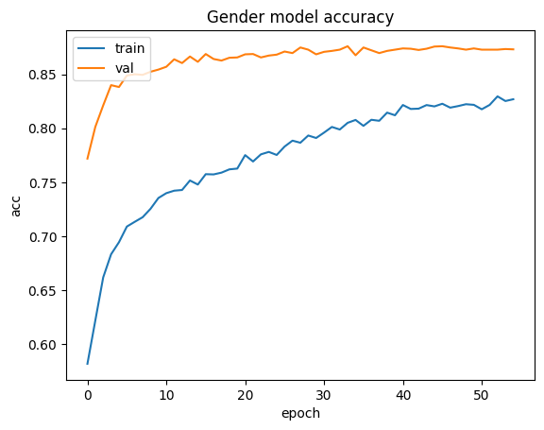
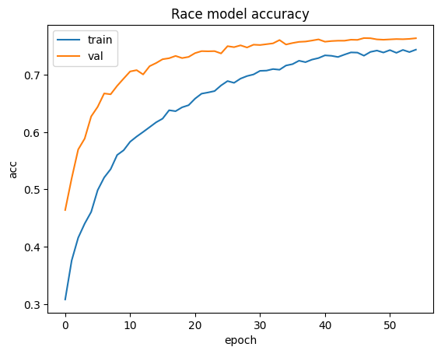
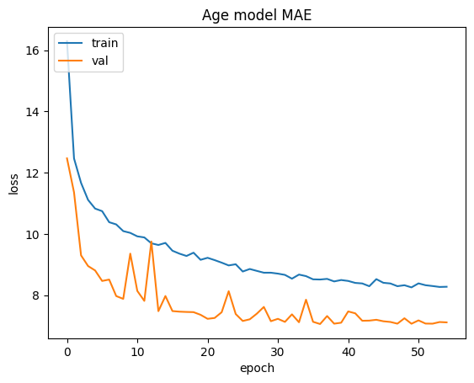
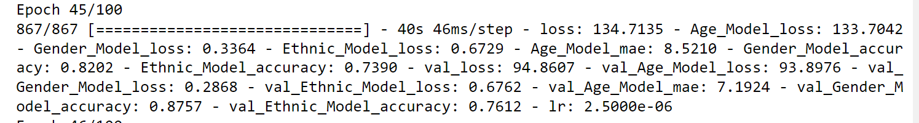
Part 3,
Methods
Model Development(cont’d)
-Adam optimizer
-Early stopping
-Learning rate reduction

Slide 13
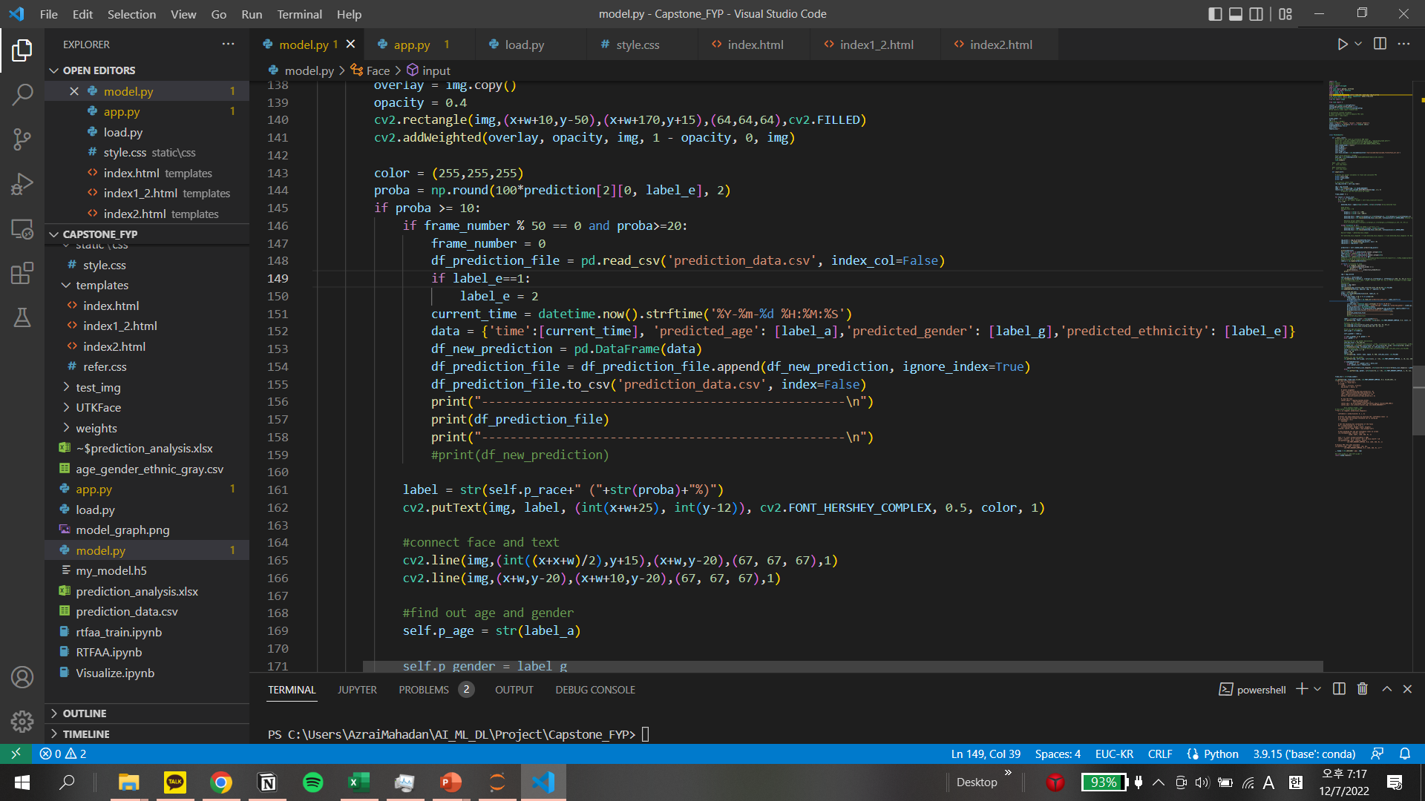
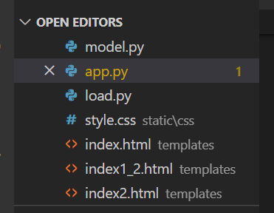
Part 3,
Methods
Model Deployment
<Codes that enable automatic data exportation to Excel>
<Main files for deployment to web server(Flask)>

Slide 14
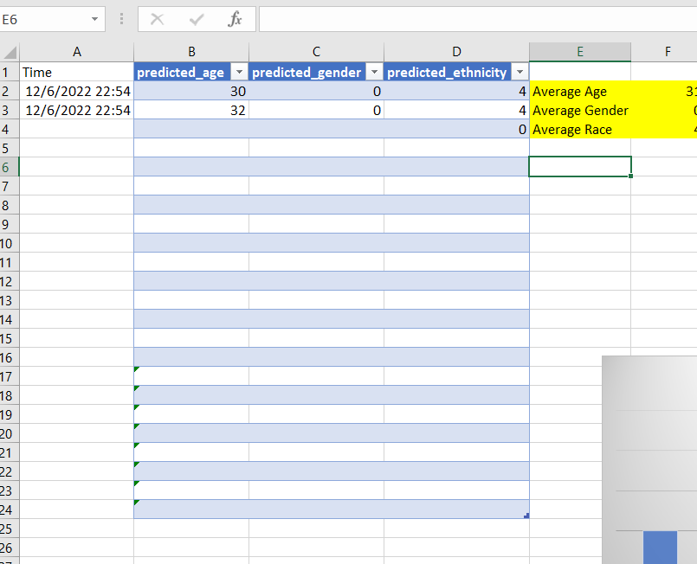
Part 3,
Methods
Model Deployment
<prediction_analysis.csv>
Automatically updates after 50 frames

Slide 15

Part 4,
Conclusion

Slide 16
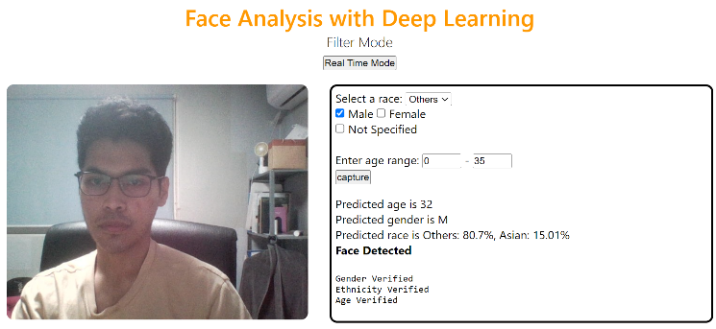
Part 4,
Conclusion
Limitation & Future Plan
01 Low/slow computation capabilities -> Increase GPU
02 Low accuracy -> Increase diversity of training images.
03 Low usability -> Deploy to mobile application.
04 Insensitive face detector ->Maybe because of location and lighting
Filter mode(in development) : Able to filter based on specified characteristics. Useful in detecting identity misrepresentation and loan approvement

Slide 17
[
[
Demo Video/시연.
[
[
감사합니다.

